Slide 1
COVID19 TRAINING PACKAGE
Module 1: INTRODUCTION TO BASICS OF COVID19 VIROLOGY, CASE DEFINITIONS, LABS AND SOPS FOR RESPONSE
Module 2: BASICS OF INFECTION PREVENTION AND CONTROL IN COVID19
Module 3: COVID19 CASE MANAGEMENT
Module 4: MANAGEMENT OF ILL TRAVELERS AT POINTS OF ENTRY (POE)
Module 5: RISK COMMUNICATION AND COMMUNITY ENGAGEMENT

Slide 2
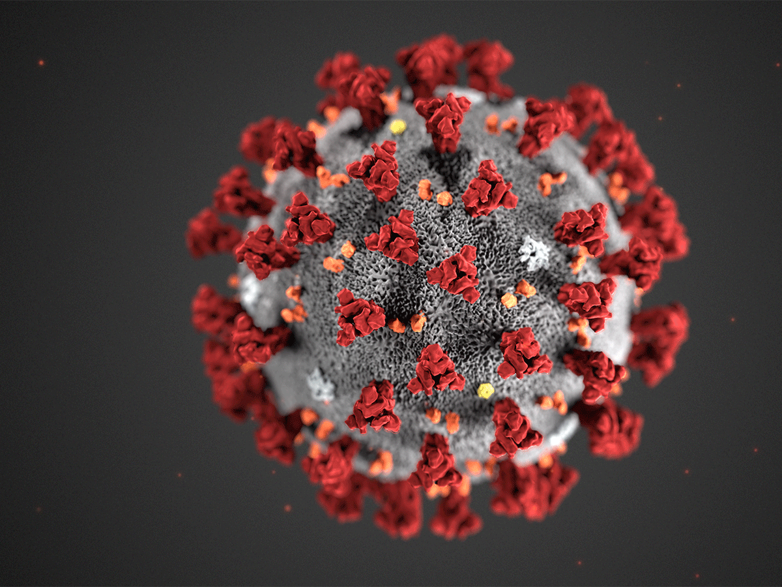
COVID-19 case-based Surveillance Module I: introduction to Basics of covid19, case definitions and sops for response
Interim Guidance version 3 as of 31 January 2020

Slide 3
What is Novel Coronavirus?
Coronaviruses (CoV) are a large family of viruses that cause illness ranging from the common cold to more severe diseases such as (MERS-CoV) and (SARS-CoV).
A novel coronavirus (nCoV) is a new strain that has not been previously identified in humans.
Coronaviruses are zoonotic, meaning they are transmitted between animals and people.
Early on, many of the patients in the outbreak in Wuhan, China reportedly had some link to a large seafood and animal market, suggesting animal-to-person spread.
Human to human transmission is confirmed now

Slide 4
Nomenclature
Official names have been announced for the virus responsible for COVID-19 (previously known as “2019 novel coronavirus”) and the disease it causes. The official names are:
CO means Corona, VI means Virus, D means Disease, 19 means the year that it was first discovered
Disease
coronavirus disease (COVID-19)
WHO announced on 11 February 2020, following guidelines previously developed with the World Organization for Animal Health (OIE) and the Food and Agriculture Organization of the United Nations (FAO)
Virus
severe acute respiratory syndrome coronavirus 2 (SARS-CoV-2)
International Committee on Taxonomy of Viruses (ICTV) announced on 11 February 2020.
This name was chosen because the virus is genetically related to the coronavirus responsible for the SARS outbreak of 2003. While related, the two viruses are different.

Slide 5
Virology
Coronaviruses are named for the crown-like spikes on their surface.
Human coronaviruses were first identified in the mid-1960s.
The natural wildlife reservoir of COVID-19 and intermediate host has not been confirmed
Suggested that the it has bat origins, just like the viruses responsible for SARS, and MERS. SARS-CoV-2 has approximately 79% sequence identity to SARS-CoV and 50% to MERS-CoV.
The novel coronavirus is 96% identical at the whole genome level to a bat betacoronavirus

Slide 6
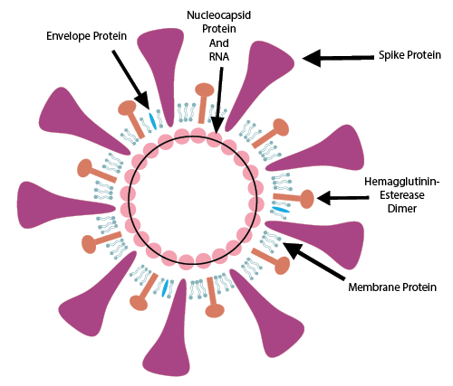
Viral Morphology
There are four coronavirus genera
alphacoronavirus,
Beta coronavirus,
Gamma coronavirus, and
Delta coronavirus.
The structure of SARS-CoV-2 consists of the following:
a spike protein (S),
hemagglutinin-esterase dimer (HE),
a membrane glycoprotein/ matrix (M),
an envelope protein (E)
a nucleocapsid protein (N) and
Single-strand RNA, non segmented, enveloped

Slide 7
Human Coronaviruses
The seven coronaviruses that can infect people are:
Common human coronaviruses
229E (alpha coronavirus)
NL63 (alpha coronavirus)
OC43 (beta coronavirus)
HKU1 (beta coronavirus)
Other human coronaviruses
MERS-CoV(the beta coronavirus that causes Middle East Respiratory Syndrome, or MERS)
SARS-CoV(the beta coronavirus that causes severe acute respiratory syndrome, or SARS)
SARS-CoV2 (COVID19)
~1/3 of common colds Reinfections common

Slide 8
Symptoms of COVID19
The most common symptoms of COVID-19 are fever, tiredness, and dry cough.
Some patients may have aches and pains, nasal congestion, runny nose, sore throat or diarrhea.
These symptoms are usually mild and begin gradually.
Some people become infected but don’t develop any symptoms and don't feel unwell.
Most people (about 80%) recover from the disease without needing special treatment.
Around 1 out of every 6 people who gets COVID-19 becomes seriously ill and develops difficulty breathing.
Older people, and those with underlying medical problems like high blood pressure, heart problems or diabetes, are more likely to develop serious illness.
About 2% of people with the disease have died.
People with fever, cough and difficulty breathing should seek medical attention

Slide 9
COVID19 incubation period
Most estimates of the incubation period for COVID-19 range from 1-14 days, most commonly around five days.
These estimates will be updated as more data become available.
Studies suggest that coronaviruses (including preliminary information on the COVID-19 virus) may persist on surfaces for a few hours or up to several days.
This may vary under different conditions (e.g. type of surface, temperature or humidity of the environment).

Slide 10
COVID19 Transmission
People can catch COVID-19 from others who have the virus.
The disease can spread from person to person through small droplets from the nose or mouth which are spread when a person with COVID-19 coughs or exhales.
These droplets land on objects and surfaces around the person.
Other people then catch COVID-19 by touching these objects or surfaces, then touching their eyes, nose or mouth.
People can also catch COVID-19 if they breathe in droplets from a person with COVID-19 who coughs out or exhales droplets.
This is why it is important to stay more than 1 meter (3 feet) away from a person who is sick.
WHO is assessing ongoing research on the ways COVID-19 is spread and will continue to share updated findings.

Slide 11
COVID19 transmission
It is possible to catch COVID-19 from someone who has, for example, just a mild cough and does not feel ill.
From a person with no symptoms, risk is very low.
The risk of catching COVID-19 from the feces of an infected person appears to be low.
While initial investigations suggest the virus may be present in feces in some cases, spread through this route is not a main feature of the outbreak.

Slide 12
(Protection measures for everyone)
Regularly and thoroughly clean your hands with an alcohol-based hand rub or wash them with soap and water.
Maintain at least 1 metre (3 feet) distance between yourself and anyone who is coughing or sneezing.
Avoid touching eyes, nose and mouth.
Make sure you, and the people around you, follow good respiratory hygiene.
This means covering your mouth and nose with your bent elbow or tissue when you cough or sneeze.
Then dispose of the used tissue immediately

Slide 13
(Protection measures for everyone)
Stay home if you feel unwell. If you have a fever, cough and difficulty breathing, seek medical attention and call in advance.
Follow the directions of your local health authority.
Stay informed on the latest developments about COVID-19.
Follow advice given by your healthcare provider, your national and local public health authority or your employer on how to protect yourself and others from COVID-19.

Slide 14
At risk
Older people, and those with pre-existing medical conditions (such as high blood pressure, heart problems or diabetes) appear to be more vulnerable
If you are in an area where there is an outbreak of COVID-19
If you are in an area where COVID-19 is spreading
If you have travelled from one of those areas
If you have been in close contact with someone who has and is feeling unwell

Slide 15
When and how to use masks
If you are healthy, you only need to wear a mask if you are taking care of a person with suspected 2019-nCoV infection.
Wear a mask if you are coughing or sneezing.
Masks are effective only when used in combination with frequent hand-cleaning with alcohol-based hand rub or soap and water.
If you wear a mask, then you must know how to use it and dispose of it properly
Before putting on a mask, clean hands with alcohol-based hand rub or soap and water.
Cover mouth and nose with mask and make sure there are no gaps between your face and the mask.
Avoid touching the mask while using it; if you do, clean your hands with alcohol-based hand rub or soap and water.
Replace the mask with a new one as soon as it is damp and do not re-use single-use masks.
To remove the mask: remove it from behind (do not touch the front of mask); discard immediately in a closed bin; clean hands with alcohol-based hand rub or soap and water.

Slide 20
Objectives of COVID-19 Surveillance
Monitor trends of disease transmission (human to human and zoonotic )
Rapidly detect new cases where virus is not circulating
Provide epidemiological information to conduct Risk Assessment
Provide Epidemiological information to guide Response Measures

Slide 21
CASE DEFINITION:SUSPECT CASE
Patient with severe acute respiratory infection
Fever and cough
requiring hospital admission
AND unexplained etiology
AND history of travel to China or any of the infected countries* history of contact 14 days prior to onset
Patient with any acute respiratory illness and at-least one of the following during 14 days prior to onset of symptoms
Contact with confirmed or probable case OF COVID19
OR worked in or visited Health Facility where confirmed or probable COVID19 patients of acute respiratory illness were being treated
*Please see list of infected countries/cities on a daily basis
OR

Slide 22
CASE DEFINITION: PROBABLE CASE
A suspected case for which:
Testing for COVID-19 is inconclusive
Tested positive using pan-corona virus assay and without lab evidence of other respiratory pathogens

Slide 23
CASE DEFINITION: CONFIRMED CASE
A person with lab confirmation of COVID-19 infection irrespective of clinical signs and symptoms

Slide 24
What to do with Confirmed Case?
Isolate
Provide palliative care
Keep isolated until 2 consecutive samples taken 24 hours apart come negative for COVID-19
Identify and monitor contacts

Slide 25
Definition of contact
Contact is anyone who:
Provided direct care to COVID19 infected patient
Working with
Healthcare workers infected with COVID19
Visitors to COVID19 patient
Family members living in same close environment of a COVID19 patient
Worked in close proximity with confirmed patient during incubation period
Sharing same classroom environment of COVID19 patient
Traveled with infected patient in any kind of conveyance
Lived in same household\with infected patient during incubation period

Slide 26
Contact Tracing
Gather following information about case contacts
Name
Address/Phone number
Demographic information
Date of first and last exposure with the case
Date of onset of symptoms in index case (fever and respiratory symptoms)

Slide 27
What to do with Contacts ? Monitoring of contacts of probable and confirmed cases
Asymptomatic Contacts
Should be monitored for 14 days from last unprotected exposure via virtual visits or telephone calls to check for symptoms
Should self-limit travel and movement
Contact the healthcare personnel in case of any respiratory symptoms
Symptomatic Contacts
Any contact who manifests respiratory symptoms becomes a suspected case and should be tested
Contact with Positive Test Results
Should have its own contacts traced and monitored

Slide 28
Minimum Reporting:
National authorities report probable and confirmed cases of novel coronavirus infection within 24 hours of identification, by providing the minimum data set.
Daily aggregated data
Reporting of the number of new confirmed and probable cases and deaths by provinces

Slide 29
Minimum Reporting
Weekly aggregated data
Cumulative number of cases and deaths since onset of outbreak;
Weekly number of reported cases, deaths, hospitalized and severe cases;
Weekly number of cases, death, hospitalised, severe cases by age-group in year (using: 0-4, 5-14, 15-24, 25-59 and greater to or equal 60; or similar) and sex.
Total number of laboratory tests conducted and that are positive for COVID19
If possible, number of contacts under follow-up and number of new identified contacts

Slide 30
Proposed algorithm

Slide 31
Specimen Collection
Lower respiratory specimen (higher diagnostic value)
Sputum
Endotracheal Aspirate
Bronchoalveolar Lavage
Nasopharyngeal Aspirate
Combined nasopharyngeal and oropharyngeal swab
Randomly selected sample of suspect cases
Sentinel surveillance
Cluster of ARI among healthcare workers

Slide 32
Materials needed for specimen collection
Dacron or polyester flocked swabs
Tongue depressor (for Oropharyngeal swab)
Vial with Viral Transport Medium (VTM)
Pen/marker
Disposable gloves
Disposable gown
N95 mask
Goggles or face shield
Specimen transport container with ice packs
Specimen label and form
Biohazard bags
Tissues
Soap and water
Hand sanitizer
Disinfectant

Slide 33
Procedure
Safety requirements and PPE
Wear disposable gloves and change gloves after each patient.
Wash or sanitize hands before putting on and after removing gloves.
Wear a N95 mask to minimize exposure to infection during specimen collection.
Follow standard precautions and any additional precautions specific to the setting or patient.
Dispose of all contaminated waste (gloves, paper, swab handles, etc.) into biohazard waste bags for disposal.
Timing
Nasopharyngeal (NP) and Oropharyngeal (OP) swabs should be collected as soon as possible after enrollment.
The NP swab for VTM should be collected first, followed by the OP swab.
Both swabs will be placed in the same vial of VTM.
Note: Placing the NP & OP swabs in the same tube increases the viral load.

Slide 34
Nasopharyngeal swab
Explain the procedure to the patient. Emphasize the importance of remaining still during specimen collection to minimize discomfort.
Position the patient in a comfortable position.
Tilt the patient’s head back at a 70-degree angle.
Remove the flocked swab from its protective package.
Insert the swab into one nostril horizontally (not upwards) and continue along the floor of the nasal passage for several centimeters until reaching the nasopharynx (resistance will be met).
The distance from the nose to the ear gives an estimate of the distance the swab should be inserted.
Do not force the swab. If obstruction is encountered before reaching the nasopharynx, remove the swab and try the other side.
Rotate the swab gently through 180 degrees to make sure adequate specimen is obtained. Leave the swab in place for 2-3 seconds to ensure absorbance of secretions.
Remove swab and immediately place into vial with VTM by inserting the swab at least ½ inch below the surface of the media.
Cut the excess swab handle to fit the transport medium vial and reattach the cap securely.

Slide 35
Oropharyngeal swab
Ask the patient to open his/her mouth.
Press the outer two-thirds of the tongue down with a tongue depressor, making the tonsils and the posterior wall of the throat visible.
Insert swab, avoiding touching the teeth, tongue, or the depressor.
Rub the swab over both tonsillar pillars and posterior oropharynx. This will cause the patient to gag briefly.
Place the swab into the vial containing VTM (same vial as the first NP swab).
Cut the excess swab handle to fit the transport medium vial and reattach the cap securely.
Carefully label specimen with patient ID number, and date and time of specimen collection.
Complete specimen tracking log with patient ID number, date and time of specimen collection.
Place specimen in cool box with ice.

Slide 36
Specimen Collection
Respiratory material (nasopharyngeal and oropharyngeal swab in ambulatory patients and sputum (if produced) and/or endotracheal aspirate or bronchoalveolar lavage in patients with more severe respiratory disease)
Serum for serological testing, acute sample and convalescent sample (this is additional to respiratory materials and can support the identification of the true agent, once serologic assay is available)
A single negative test result, particularly if this is from an upper respiratory tract specimen, does not exclude infection.
Repeat sampling and testing, lower respiratory specimen is strongly recommended in severe or progressive disease.
A positive alternate pathogen does not necessarily rule out either, as little is yet known about the role of coinfections.

Slide 38
Recommendations for specimen collection
If initial testing is negative in a patient who is strongly suspected to have novel coronavirus infection, the patient should be resampled and specimens collected from multiple respiratory tract sites (nose, sputum, endotracheal aspirate).
Additional specimen may be collected such as blood, urine, and stool, to monitor the presence of virus of and shedding of virus from different body compartments.
.
When serological assays become available, WHO recommends that a paired acute and convalescent sera for antibody detection should also be collected where possible.

Slide 39
Case Based Surveillance COVID-19
PDSRUs will be responsible for case based surveillance and response in Provinces and regions while FDSRU will be responsible for ICT surveillance and case response
PDSRUs will finalize the focal persons at district level through FELTP trained workforce (FELTP alumni/ N-STOP Officers/ fellows/ frontline workers) and will share with FEDSD with their contact details.
If N-STOP officers are allowed to support, then districts in which they are posted will be their responsibility.
Suspected cases and contacts will be further investigated using pre-structured questionnaire and is already shared with PDSRUs

Slide 40
Case Based Surveillance COVID-19
PDSRUs will enter the information in online software
Response will be generated at the level of suspected case admission (District/ Province/Federal)
Sample collection and transportation and feedback mechanism will be linked with DSRUs
DoH will stockpile PPEs and viral transport medium and disburse to the DHOs of the respective districts
The FDSRU Office Landline: 051-9255815, Fax: 051-9255814

Slide 41
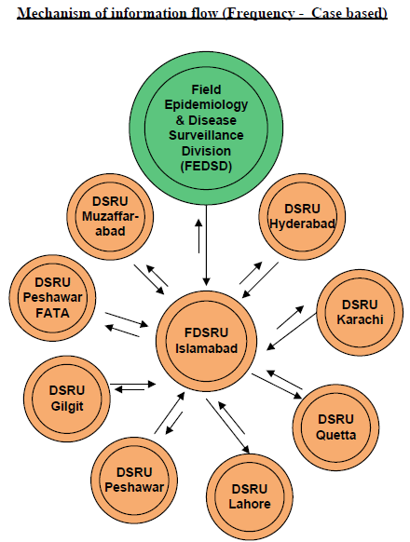

Slide 42
Components of Case Based Surveillance
There will two components of case-based surveillance;
Suspected case investigation
Contact tracing with data management.

Slide 43
Suspected case investigation
FDSRU and PDSRUs will assign one dedicated team for case investigation, surveillance data management and report preparation
FDSRUS and PDSRUs will collect all suspected cases information on prestructured questionnaire from designated hospitals (annex-1)
Suspected cases and contacts will be further investigated using pre-structured questionnaire which is already shared with PDSRUs
PDSRUs will enter the investigated cases information in an online software developed by NIH Islamabad

Slide 44
Contact tracing and data management
Airport teams will share data of passengers including contact numbers traveling from China and other infected countries on daily basis with FDSRU in Islamabad and PDSRUs in Provinces
Airport Teams will inform respective DSRUs and RRTs regarding suspected cases and RRT will shift these cases to the designated hospitals in their respective areas
FDSRU and PDSRUs will maintain database of passengers record received from Airports
FDSRU and PDSRUs teams will maintain contact list of suspected cases and will follow up with contacts periodically within 02 incubation periods
FDSRU and PDSRU Teams will contact listed passengers periodically to
Ask about any Sign/symptoms related to Corona virus illness
Guide them taking precautionary measures
Guide them to nearest designated hospitals

Slide 45
Flow of events
Screening Team
Rapid Response Team
Disease Surveillance Team

Slide 46
COMPOSITION OF SCREENING TEAM
Team Leader (Airport Health Officer)
Medical Management personnel (doctor and/nurse)
Logistician
Environmental health specialists
Hazardous material teams
Psychosocial support experts
Communication expert
IT support / Administrative Staff
Ambulance Team

Slide 47
SOPs for Screening Team
Team lead will prepare operational plan about how to screen flight before arrival of the flight
Team will lead will brief the team, and assign roles and responsibilities to every team member
Upon arrival of flight screening personnel will welcome the passengers, take their health declaration forms, check fever through thermal guns, mark red or green on the form, and then guide them to relevant counter.
Psychosocial experts on health counter will counsel the passengers and handover necessary IEC material to them.
Medical management personnel will carry out preliminary interview of the suspected case as per case definition and assess whether the passenger fulfil criteria of suspected case or not.
If passenger do not fulfil criteria of suspected case, then they will guide them to health counter.
If passenger fulfil the criterial of suspected case then they will provide mask to passenger and ask psychosocial expert to counsel them.
Medical management personnel then inform team lead.
Team lead will inform Rapid Response Team (RRT) and take suspected case to separate room / area.
Team lead will make necessary arrangements before arrival of RRT.

Slide 48
SOPs for screening team
IT support / Administrative Staff will carry out necessary administrative procedure with immigration and airport administration.
Communication expert will talk to family or persons who came to receive the passenger and counsel them.
If required communication expert will communicate with media also.
If necessary, ambulance team will take suspected case to another retention area near airport whether RRT will arrive and carry out their required procedures.
Team lead will remain in coordination with RRT for further procedures.

Slide 49
COMPOSITION OF RAPID RESPONSE TEAM
Team Leader (DHO / need based)
Medical Management personnel (doctor and/nurse)
Epidemiologist/Surveillance Officer
Communication expert
Logistician
Laboratorians
Infection Prevention and Control expert
Psychosocial support experts
Environmental health specialists
Hazardous material teams
Media expert
IT support / Administrative Staff
Ambulance Team

Slide 50
SOPs OF RAPID RESPONSE TEAM
Preparation for field work and briefing to the team.
Team lead assign and clarify roles and responsibilities to every team member
Upon receipt of information from Airport health department (CHE), Team lead will communicate with all relevant stakeholder and inform about time of departure and time of arrival from destination to airport and from airport to hospital.
Team will arrive at airport as per plan laid out on need basis.
Team lead will coordinate / report to airport health department and take all relevant details.
Medical management personnel will approach suspected case in PPE, and take passenger to ambulance
Psychosocial support experts will carry out counselling of the suspected case, his family members, general passengers, airport staff etc.
Media expert will handle media if required
IPC team and hazardous control team will disinfect the area and safely dispose of waste if required.
IT support / Administrative Staff will conduct relevant administrative procedures with CHE, airport authorities, immigration and other relevant stakeholders.

Slide 51
SOPs OF RAPID RESPONSE TEAM
Ambulance team will coordinate with designated hospital focal point or relevant staff for arrival time of patient to make necessary arrangements.
Medical management personnel will coordinate with focal person of hospital and provide all information and necessary instruction as required.
Epidemiologist / Disease Surveillance Officer will take all relevant data of the suspected case, and close contacts.
Team lead will ascertain that all the relevant procedures will be followed before leaving airport
Normalcy on airport will be maintained and no routine process will be halted.
Team lead will share data with relevant stakeholders.
Team lead will debrief to the team and give more instruction to team on basis of gaps if identified during the work.

Slide 52
Composition of Disease Surveillance Team
Team Leader (TSO FELTP / need based)
Medical Management personnel (doctor and/nurse)
Epidemiologist/Surveillance Officer
Communication expert
Logistician
Laboratorians
Infection Prevention and Control expert
Psychosocial support experts
Environmental health specialists
Hazardous material teams
Media expert
IT support / Administrative Staff
Ambulance Team

Slide 53
SOPs for Disease Surveillance Team
Preparation for field work plan and briefing to the team.
Team lead assign and clarify roles and responsibilities to every team member
Upon receipt of information from Rapid Response Team (RRT), Team lead will communicate with all relevant stakeholder and inform about plan for contact tracing.
Team lead will all relevant details from RRT.
Logistician will make all the necessary logistic arrangements
Team will go to the area of residence of close contacts of suspected case as per plan laid out on need basis.
Epidemiologist conduct active contact tracing and use questionnaire developed by MoNHSRC, NIH & CHE or use standard WHO guidelines.
Medical management personnel will carry out preliminary examination of close contact and assess whether the contact need to be hospitalized or quarantined at home.
Psychosocial support experts will carry out health awareness and education session in the community.
Media expert will handle media if required

Slide 54
SOPs for Disease Surveillance Team
IPC team and hazardous control team will disinfect the area and safely dispose of
waste if required.
IT support / Administrative Staff will conduct relevant administrative procedures with CHE, airport authorities, immigration and other relevant stakeholders.
Ambulance team will coordinate with designated hospital focal point or relevant staff for arrival time of patient to make necessary arrangements.
Medical management personnel will coordinate with focal person of hospital and provide all information and necessary instruction as required.
Team lead will ascertain that all the relevant procedures will be followed before leaving the area.
Normalcy in the area will be maintained and no routine work will be halted.
Team lead will share data with relevant stakeholders.
Team lead will debrief to the team and give more instruction to team on basis of gaps if identified during the work.

Slide 55
Rapid response Team will be activated and will undertake following tasks;
Through extensive field investigation, try to determine
Size of geographic area of spread
Spectrum of clinical presentation
Natural course of disease
Mode of transmission
Extent of human to human transmission
Source of zoonotic transmission
Mitigation measures
Best practices for treatment

Slide 56
PEI COVID19 Surveillance Synergy
Training of PEOC staff (DivSO/District SOs/DSCs/PEOs) at provincial capitals on COVID19/SARI case definitions and surveillance and basics of IPC, lab PoEs, contact tracing and case management..
The trained PEI surveillance staff will trickle down this expertise at district levels through orientation sessions and interactions with health care providers and support government focal points establish a functional COVID19 sentinel surveillance systems in designated hospitals (Govt and private teaching hospitals and DHQs only).

Slide 57
PEI COVID19 Surveillance Synergy
Conduct ad hoc active case search on a weekly basis to support government focal points in teaching hospitals, DHQs and private teaching hospitals only (as sentinel case-based surveillance). Active surveillance plans will be modified by surveillance officers to prioritize teaching hospitals and tertiary hospitals in both government and private sector.
Surveillance officers will also be expected sensitize and/or orient healthcare providers on case definitions and encourage notifications.
Inclusion of an extra line on weekly zero report form for COVID19/SARI as part of passive surveillance from government staff designated at zero sites.

Slide 58
PEI COVID19 Surveillance Synergy
Reporting any info to the PDSRU focal person and notified district Rapid Response Team and Disease Surveillance Team

Slide 64
MODULE II: BASICS OF INFECTION PREVENTION AND CONTROL IN COVID19

Slide 65
Introduction
With the current information available, it is suggested that the route of human-to-human transmission of 2019-nCoV is either via respiratory droplets or contact.
Any person who is in close contact (within 1 meter) with someone who has respiratory symptoms (e.g., sneezing, coughing, etc.) is at risk of being exposed to potentially infective respiratory droplets.
Medical masks are surgical or procedure masks that are flat or pleated (some are like cups); they are affixed to the head with straps.

Slide 66
GENERAL ADVICE
Wearing a medical mask is one of the prevention measures to limit spread of certain respiratory diseases, including COVID19, in affected areas.
However, the use of a mask alone is insufficient to provide the adequate level of protection and other equally relevant measures should be adopted.
If masks are to be used, this measure must be combined with hand hygiene and other IPC measures to prevent the human-to-human transmission of COVID19.
WHO has developed guidance for home care and health care settings on infection prevention and control (IPC) strategies for use when infection with COVID19 is suspected.

Slide 67
GENERAL ADVICE
Wearing medical masks when not indicated may cause unnecessary cost, procurement burden and create a false sense of security that can lead to neglecting other essential measures such as hand hygiene practices.
Using a mask incorrectly may hamper its effectiveness to reduce the risk of transmission.

Slide 68
COMMUNITY SETTING
Individuals without respiratory symptoms should:
- avoid agglomerations and frequency of closed crowded spaces;
- maintain distance of at least 1 meter from any individual with COVID19 respiratory symptoms (e.g., coughing, sneezing);
- perform hand hygiene frequently, using alcohol-based hand rub if hands are not visibly soiled or soap and water when hands are visibly soiled;
- if coughing or sneezing cover nose and mouth with flexed elbow or paper tissue, dispose of tissue immediately after use and perform hand hygiene;
- refrain from touching mouth and nose;
a medical mask is not required, as no evidence is available on its usefulness to protect non-sick persons. However, masks might be worn in some countries according to local cultural habits.
If masks are used, best practices should be followed on how to wear, remove, and dispose of them and on hand hygiene action after removal

Slide 69
COMMUNITY SETTING
Individuals with respiratory symptoms should:
- wear a medical mask and seek medical care if experiencing fever, cough and difficulty breathing, as soon as possible or in accordance with to local protocols;
- follow the advice regarding appropriate mask management.

Slide 70
HOME CARE
Individuals with suspected 2019-nCoV infection with mild respiratory symptoms should:
- perform hand hygiene frequently, using alcohol-based hand rub if hands are not visibly soiled or soap and water when hands are visibly soiled;
- keep distance from well individuals as much as possible (at least 1 meter);
to contain respiratory secretions, a medical mask should be provided to the individual and worn as much as possible, if it can be tolerated.
For individuals who cannot tolerate a medical mask, he/she should rigorously apply respiratory hygiene, i.e. cover mouth and nose when coughing or sneezing with disposable paper tissue.
Dispose of the material after use. Clean hands immediately after contact with respiratory secretions;
- improve airflow in living space by opening windows and door as much as possible.

Slide 71
HOME CARE
Relatives or caregivers to individuals with suspected COVID19 infection with mild respiratory symptoms should:
- perform hand hygiene frequently, using alcohol-based hand rub if hands are not visibly soiled or soap and water when hands are visibly soiled;
- keep distance from affected individual as much as possible (at least 1 meter);
- wear a medical mask when in the same room with the affected individual;
- dispose of the material immediately after use. Clean hands immediately after contact with respiratory secretions;
- improve airflow in living space by opening windows as much as possible.

Slide 72
IPC strategies to prevent or limit transmission in healthcare settings
1. Ensuring triage, early recognition, and source control (isolating patients with suspected COVID19 infection);
2. Applying standard precautions for all patients;
3. Implementing empiric additional precautions (droplet and contact and, whenever applicable, airborne precautions) for suspected cases of COVID19 infection;
4. Implementing administrative controls;
5. Using environmental and engineering controls.

Slide 73
Applying standard precautions for all patients
Ensure that the following respiratory hygiene measures are used:
• ensure that all patients cover their nose and mouth with a tissue or elbow when coughing or sneezing;
• offer a medical mask to patients with suspected COVID19 infection while they are in waiting/public areas or in cohorting rooms;
• perform hand hygiene after contact with respiratory secretions.

Slide 74
Applying standard precautions for all patients
HCWs should apply the WHO’s My 5 Moments for Hand Hygiene approach before touching a patient, before any clean or aseptic procedure is performed, after exposure to body fluid, after touching a patient, and after touching a patient’s surroundings.
• hand hygiene includes either cleansing hands with an alcohol-based hand rub (ABHR) or with soap and water;
• alcohol-based hand rubs are preferred if hands are not visibly soiled;
• wash hands with soap and water when they are visibly soiled.

Slide 75
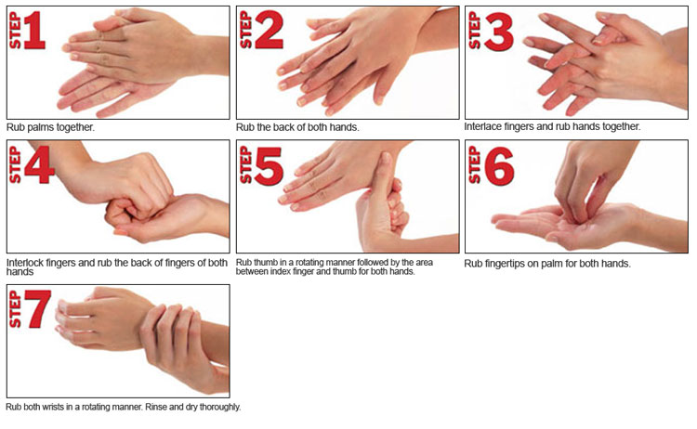
HOW DO I PRACTICE HAND HYGIENE CORRECTLY?

Slide 77
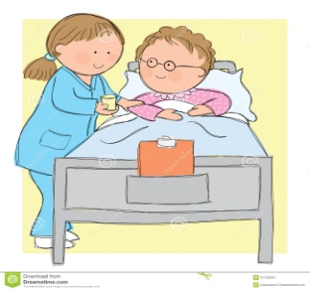
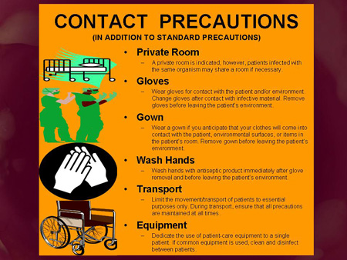
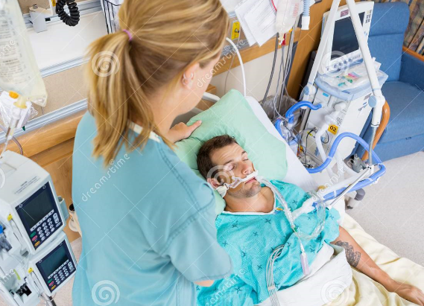
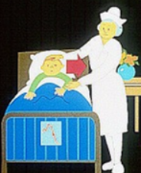
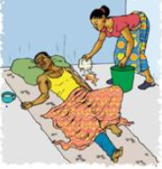
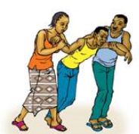
Contact transmission

Slide 78
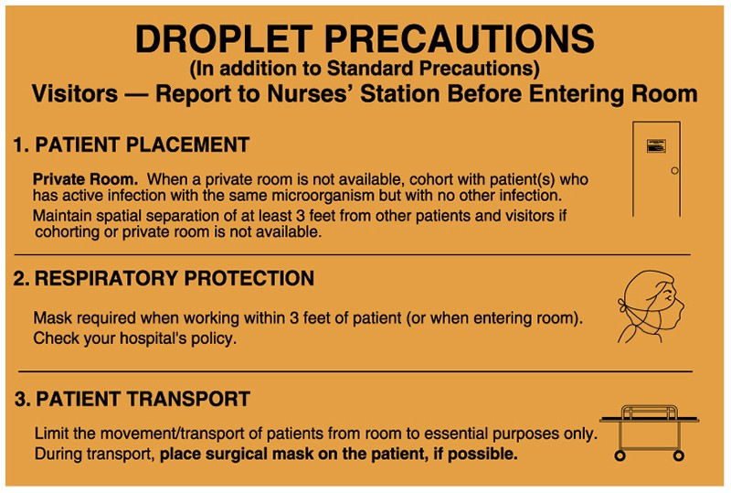
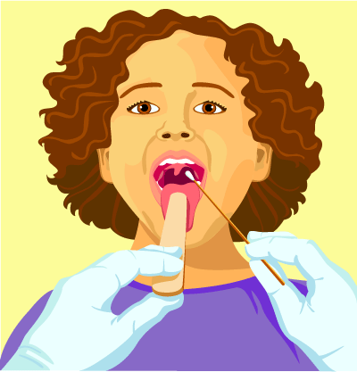
Droplet precautions
Diseases which are transmitted by this route include pneumonias, pertussis, diphtheria, influenza type B, mumps, and meningitis
Large particle droplets (> 5 microns)
Droplets are usually generated from the infected person during coughing, sneezing, talking or when health care workers undertake procedures such as suctioning

Slide 79
Contact and droplet precautions
• Patients should be placed in adequately ventilated single rooms. For general ward rooms with natural ventilation, adequate ventilation is considered to be 60 L/s per patient;9
• When single rooms are not available, patients suspected of being infected with nCoV should be grouped together;
• All patients’ beds should be placed at least 1 m apart regardless of whether they are suspected to have nCov infection;
• Where possible, a team of HCWs should be designated to care exclusively for suspected or confirmed cases to reduce the risk of transmission;
• HCWs should use a medical maska (for specifications, please see references 2);
• HCWs should wear eye protection (googles) or facial protection (face shield) to avoid contamination of mucous membranes;
• HCWs should wear a clean, non-sterile, long-sleeved gown;
• HCWs should also use gloves;

Slide 80
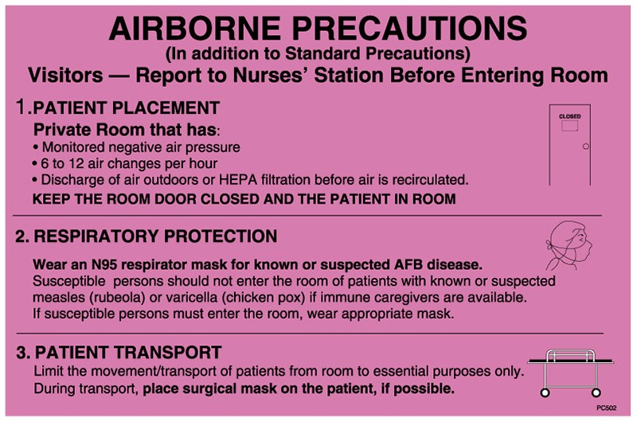
Airborne Transmission
Airborne transmission occurs when droplet nuclei (evaporated droplets) <5 micron in size are disseminated in the air.
These droplet nuclei can remain suspended in the air for long periods of time.
Diseases which spread by this mode include
open/active pulmonary tuberculosis (TB),
measles, chicken pox, pulmonary plague
and haemorrhagic fever with pneumonia.

Slide 81
Airborne Precautions
Perform procedures in an adequately ventilated room – that is, natural ventilation with air flow of at least 160 L/s per patient or in negative pressure rooms with at least 12 air changes per hour and controlled direction of air flow when using mechanical ventilation;
Use a particulate respirator at least as protective as a US National Institute for Occupational Safety and Health (NIOSH)-certified N95, European Union (EU) standard FFP2, or equivalent.
When HCWs put on a disposable particulate respirator, they must always perform the seal check.12 Note that if the wearer has facial hair (i.e., a beard) it may prevent a proper respirator fit;
use eye protection (i.e., goggles or a face shield);
wear a clean, non-sterile, long-sleeved gown and gloves. If gowns are not fluid resistant, HCWs should use a waterproof apron for procedures expected to have high volumes of fluid that might penetrate the gown;

Slide 82
HEALTH CARE FACILITIES
Individuals with respiratory symptoms should:
- wear a medical mask while waiting in triage or waiting areas or during transportation within the facility;
- wear a medical mask when staying in cohorting areas dedicated to suspected or confirmed cases;
- do not wear a medical mask when isolated in single rooms but cover mouth and nose when coughing or sneezing with disposable paper tissues. Dispose them appropriately and perform hand hygiene immediately afterwards.

Slide 83
HEALTH CARE FACILITIES
Health care workers should:
wear a medical mask when entering a room where patients suspected or confirmed of being infected with COVID19 are admitted and in any situation of care provided to a suspected or confirmed case;
use a particulate respirator at least as protective as a US National Institute for Occupational Safety and Health (NIOSH)-certified N95, European Union (EU) standard FFP2, or equivalent, when performing aerosol-generating procedures such as tracheal intubation, non-invasive ventilation, tracheotomy, cardiopulmonary resuscitation, manual ventilation before intubation, and bronchoscopy.

Slide 84
MASKS MANAGEMENT
If medical masks are worn, appropriate use and disposal is essential to ensure they are effective and to avoid any increase in risk of transmission associated with the incorrect use and disposal of masks.
The following information on correct use of medical masks derives from the practices in health-care settings:
- place mask carefully to cover mouth and nose and tie securely to minimise any gaps between the face and the mask;
- while in use, avoid touching the mask;
- remove the mask by using appropriate technique (i.e. do not touch the front but remove the lace from behind);

Slide 85
MASKS MANAGEMENT
- after removal or whenever you inadvertently touch a used mask, clean hands by using an alcohol-based hand rub or soap and water if visibly soiled
- replace masks with a new clean, dry mask as soon as they become damp/humid;
- do not re-use single-use masks;
- discard single-use masks after each use and dispose of them immediately upon removal.
Cloth (e.g. cotton or gauze) masks are not recommended under any circumstance.

Slide 86
MODULE III: COVID-19 CASE MANAGEMENT

Slide 87
Objectives
Triage; recognize and sort patients with SARI
Implementation of Infection prevention and control (IPC) measures
Early Supportive Therapy and Monitoring
Collection of specimen for lab diagnosis
Management of hypoxic respiratory failure and ARDS
Management of septic shock
Prevention of complications
Specific COVID-19 treatments
Special considerations for pregnant patients

Slide 88
Early Recognition of SARI (Severe Acute Respiratory illness)
Mild illness
Moderate Illness
Severe Illness
ARDS
Sepsis
Septic Shock
Fever
Cough
Sore-throat
Nasal congestion
Malaise
Fever
Difficulty breathing
Cough
Fast breathing
Severe Pneumonia

Slide 89
Implementation of infection prevention and control measures

Slide 90
Droplet precaution
Give suspected patient a medical mask
Direct patient to separate area/isolation
Keep distance of at least 1 meter between suspected and other patient
Cover nose and mouth during sneezing/coughing with flexed elbow
Perform hand hygiene frequently

Slide 91
Contact Precaution
Use PPE (mask, goggles, gloves, gown), observe proper donning and doffing methods
Use disposable or dedicated equipment (stethoscope, BP cuffs and thermometers) – clean equipment between use on different patients
Refrain from touching eyes, nose and mouth with potentially contaminated gloved or ungloved hands
Avoid contaminating environmental surfaces e.g. door knobs and light switches
Ensure adequate room ventilation
Avoid unnecessary patient movement/ transport

Slide 92
Airborne Precaution
To be applied when performing an aerosol generating procedure i.e.
Open suctioning of respiratory tract
Intubation
Bronchoscopy
CPR
Use PPE & adequately ventilated single rooms
Gloves
Gowns
Eye protection
Fit tested particulate respirators (N95 or equivalent)

Slide 93
Early Supportive Therapy & Monitoring
Give supplemental oxygen therapy immediately to patients with SARI, respiratory distress, hypoxemia or shock.
Use conservative fluid management in patients with SARI when there is no evidence of shock.
Give empiric antimicrobials to treat other likely pathogens that may cause SARI (specially in patients of sepsis)
Do not routinely give systemic corticosteroids unless they are indicated for another reason (may delay LRT clearance of virus)
Closely monitor patients with SARI for signs of clinical deterioration and apply supportive care intervention immediately
Tailor patient management according to any co-morbid conditions if present

Slide 94
Specimen Collection
COVID-19 testing is done by RT-PCR
Blood cultures for bacteria that cause pneumonia before starting empirical antimicrobial therapy to rule out other causes of pneumonia or super-infections
URT samples (nasopharyngeal and oropharyngeal swabs)
LRT samples (expectorated sputum, endotracheal aspirate or bronchoalveolar lavage)
Sputum induction should be avoided due to increased risk of aerosol transmission

Slide 95
Management of Hypoxic Respiratory Failure & ARDS
High flow nasal oxygen or non-invasive ventilation to only be used in selective patients with hypoxemic respiratory failure and should be closely monitored for clinical deterioration
Endotracheal intubation for ventilatory support should be performed by trained individual using airborne precautions
Implement mechanical ventilation using low tidal volume and low inspiratory pressures
Use conservative fluid management strategy for ARDS patients without tissue hypoperfusion
In patients with moderate-severe ARDS, neuromuscular blockade by continuous infusion should not be used (light sedation preferred)
Consider referral of patients with refractory hypoxemia (despite ventilatory support) to settings with Extracorporeal Life Support

Slide 96
Management of Septic Shock
Use isotonic crystalloids for resuscitation (Do not use hypotonic crystalloids, starches or gelatins)
Fluid resuscitation must be cautiously monitored as volume overload may cause respiratory failure
Administer vasopressors if shock persists despite fluid resuscitation. Monitor for signs of extravasation and local tissue necrosis.
If signs of poor perfusion and cardiac dysfunction persist, consider an inotrope such as dobutamine.

Slide 97
Prevention of Complications
Prevent | Interventions
Long term invasive mechanical ventilation | Weaning protocols Minimize continuous or intermittent sedation
ventilator associated pneumonia | Oral intubation Semi-recumbent position Closed and regular suctioning
venous thromboembolism | Prophylaxis through anticoagulants
catheter related bloodstream infection | Sterile insertion Immediate removal if not needed
pressure ulcers | Frequent position change
stress ulcers and GI bleeding | Early enteral nutrition Histamine-2 receptor blockers or proton pump inhibitors
ICU related weakness | Active mobilization when safe

Slide 98
Specific Anti covid-19 treatments
There is no current evidence to recommend any specific anti COVID-19 treatment for patients with suspected or confirmed infection

Slide 99
Special Considerations for pregnant patients
Pregnant women with suspected or confirmed COVID-19 infection should be treated with supportive therapies, taking in to account physiologic adaptations of pregnancy
Emergency delivery and pregnancy termination decisions should be made in consultation with obstetric, neonatal and intensive care specialists bases on gestational age, maternal condition and fetal stability.

Slide 100
Module IV: Management of ill travelers at Points of Entry (PoE) – international airports, seaports and ground crossings – in the context of COVID-19 outbreak

Slide 101
Overview
Under the International Health Regulations (IHR), the public health authorities at international ports, airports and ground crossings are required to
establish effective contingency plan and arrangements for responding to events that may constitute a public health emergency of international concern (PHEIC) and
to communicate with the National IHR Focal Point (NIH Islamabad) on the relevant public health measures.
The current COVID-19 outbreak has spread across several borders, which has prompted the demand for the detection and management of suspected cases at Points of Entry (PoE), including ports, airports and ground-crossing including on conveyances.

Slide 102
Summary
Following measures, to be implemented
Detection of ill travellers
Interview of ill travellers for COVID-19
Reporting of alerts of ill travellers with suspected COVID-19 infection
Isolation, initial case management and referral of ill travellers with suspected COVID-19 infection

Slide 103
Audience
National IHR Focal Points,
PoE public health authorities,
PoE operators,
Conveyance operators,
Other stakeholders involved in the management of Public health events at PoE
Establishing coordination between
FIA
ASF
CAA
CHE
ED/Directors of the Hospitals
LEAs
Ministry/Departments of Health

Slide 104
1. Detection of Ill Travellers at international Points of Entry- Planning
Staff
Appropriate number of trained personnel assigned for these duties,
volume of travellers
frequency of travellers
complexity of the PoE regarding terminal facilities.
Staff should be trained on protecting themselves by maintaining more than one meter between themselves and travellers, at all time, (also known as ‘social distancing’).
Encourage travellers to maintain more than one-meter distance between themselves while waiting to cross the PoE, including when completing entry forms.
One health care worker on-site and designated to support the staff at the point of entry in case of ill travellers or suspected COVID-19 cases that require urgent direct clinical care.
These health care workers should have a supply of recommended Personal Protective Equipment (PPE) for health care workers
(i.e. contact and droplet precautions plus goggles/eye protection) and
Follow the infection prevention and control guidelines in case there is an urgent or emergent need to provide direct patient care for an ill traveller or a suspected case.

Slide 105
1. Detection of Ill Travellers at international Points of Entry- Planning
Equipment
If temperature screening has been chosen, ascertain temperature by
no-touch thermometers,
either handheld or
thermal imaging cameras
Manual thermometers that require contact with skin or mucous membranes should not be used.

Slide 106
1. Detection of Ill Travellers at international Points of Entry- Implementation
Self-reporting: with increased knowledge among travellers on COVID-19, including
through active and targeted risk communications for travellers at PoE,
individual travellers experiencing signs and symptoms of illness may approach PoE authorities for assistance.
These self-reporting ill travellers should be managed following the same procedures.
Visual observation: ill travellers exhibiting signs suggestive of COVID-19 may be identified by PoE personnel when passing through PoE facilities.

Slide 107
1. Detection of Ill Travellers at international Points of Entry- Implementation
Detection via temperature measurement in countries that choose to perform screening.
When a traveller
displaying sign(s) of an illness is detected by a PoE health personnel and/or
through temperature measurement, or
when a traveller experiencing symptom(s) of illness comes forward to seek help from PoE health personnel,
He/she and his/her travel companions need to be advised to move away from the crowd and be escorted to a dedicated physical structure at the PoE for further assessment
PoE personnel accompanying the ill traveller must keep a distance of at least one meter from the ill traveller.
A dedicated physical structure should be identified for further assessment/ interview

Slide 108
2. Interview of ill travellers for COVID-19- Planning
Facilities
Set up/identify a structure where ill travellers can be referred to and wait for interview near the PoE.
Ensure this space has the ability for at least 1-meter spatial separation among ill travellers waiting for an interview.
Ideally this structure should also have the capacity to isolate ill travellers who are suspected of having COVID-19 after interview while they wait for transport to a health care facility.
Arrangements with local health care facilities should be established so that travellers that are suspected of COVID-19 infection after interview can be promptly referred to health care facilities.
Arrangements should be made so that a quarantine facility located in a distant place from the PoE is available, in case there is a need to accommodate a large number of contacts with suspected and confirmed cases.

Slide 109
2. Interview of ill travellers for COVID-19- Planning
Staff
Identify and train staff for
interview;
security; and
transportation for possible referrals to medical facilities for further medical evaluation or treatment.
Provide staff with training on
practice of adequate hand hygiene technique;
maintaining one-meter distance from travellers at all times during the interview process;
how to educate and address the patient and concerns of his family and/or travel companions.
Provide staff with training on the importance of source control (providing medical masks to travellers with respiratory symptoms before and during the interview process).
Provide staff with training on
how to instruct ill travellers on use of respiratory hygiene (i.e., coughing or sneezing into tissues or bent elbow) and
need for ill travellers to wear a mask, perform frequent hand hygiene, especially after coughing/sneezing, touching or disposal of their mask

Slide 110
2. Interview of ill travellers for COVID-19- Planning
Equipment
Identify needs for, procure and ensure sustained supply of equipment and materials needed to perform interview.
Ensure enough supply of hand hygiene supplies, alcohol-based hand rub or soap and water.
Ensure respiratory hygiene supplies, including medical masks (to be used by ill patients with respiratory symptoms) and paper tissues.
Ensure lined waste bins with a lid for disposing of medical masks and tissues and a plan for disposal of this waste in accordance with infectious waste regulations.
Ensure cleaning supplies including household cleaner and disinfectant
Ensure chairs and/or beds at isolation areas for ill travellers

Slide 111
2. Interview of ill travellers for COVID-19- Planning
Plans / SOPs
Develop a process to refer exposed travellers, including travel companions of symptomatic travellers suspected of COVID-19 infection, to health care facilities for further assessment and treatment.
Cleaning and disinfection guidelines for frequently touched surfaces and bathrooms in the interview area should be made available.
Cleaning should be done three times a day (morning, afternoon, night) with regular household soap or detergent first and then, after rinsing, regular household disinfectant containing 0.5% sodium hypochlorite (i.e. equivalent 5.000 pm or 1-part bleach of 9 parts of water) should be applied
The local sanitary authority should adopt measures to ensure that the waste is disposed at a sanitary landfill, and not at an unmonitored open dump.
Establish and maintain a PoE public health emergency contingency plan, including the nomination of a coordinator and contact points for relevant PoE, public health and other agencies (for example, authorities for aviation, maritime, refugees) and services.

Slide 112
2. Interview of ill travellers for COVID-19- Planning
Other services
Identify transport for suspect cases to identified health care facilities.
Identify service provider to apply recommended measures to clean and disinfect affected areas at PoE and on-board conveyance and ensure infected waste properly managed.
Develop a process to refer exposed travellers, including travel companions of symptomatic travellers suspicious of COVID-19 infection, to health care facilities for further assessment and treatment.

Slide 113
2. Interview of ill travellers for COVID-19- Implementation of interview
Interview for COVID-19 includes the following
temperature measurement with no-touch thermometer technology;
assessment of signs and symptoms suggestive of COVID-19 by interview/observation only (PoE personnel should not conduct a physical examination);
travel/contact history through completion of the Public Health Declaration Form by the traveller and evaluation of the answers provided on th the form;
additional observation by the PoE health personnel.

Slide 114
2. Interview of ill travellers for COVID-19- Implementation of interview
Travellers should be assessed for the following:
A. Signs or symptoms of illness suggesting respiratory infection
Fever greater than 38° C or feeling feverish;
Cough
Breathing difficulties
B. History of possible exposure to the COVID-19;
history of travel to country(ies) with ongoing transmission of COVID-19, 14 days prior to the onset of symptoms;
history of a visit to any health care facility(ies) at country(ies) with ongoing transmission in the 14 days prior to symptom onset

Slide 115
2. Interview of ill travellers for COVID-19- Implementation of interview
Travellers should be assessed for the following:
B. History of possible exposure to the COVID-19;
history of close physical contact with a traveller suspected or confirmed of COVID-19 infection in the past 14 days;
history of a visit to any live animal markets at country(ies) with ongoing COVID-19 transmission in the 14 days prior to symptom onset.
Travellers suspected of COVID-19 infection after interview and exhibiting clinical symptoms consistent with respiratory infection and/or a history of possible exposure to the COVID-19 should be immediately isolated at the PoE and referred to a pre-identified health care facility for additional medical evaluation and treatment.
Relevant public health authorities should also be notified.

Slide 116
Close physical contact for COVID-19
Travel and classrooms
Healthcare settings
Traveling together with suspected or confirmed COVID-19 patient in any kind of conveyance (2 seats in every direction with the ill traveller, and the cabin crew)
Working together in close proximity or sharing the same classroom environment with a suspected or confirmed COVID-19 patient
Visiting patients or staying in the same close environment of a suspected or confirmed COVID-19 patient.
Health care associated exposure, including providing direct care for suspected or confirmed COVID-19 patients, working with health care workers suspected or confirmed COVID-19 infection, without appropriate specific droplet and contact precautions

Slide 117
3. Reporting of alerts of ill travellers with suspected COVID-19 infection- Planning
Establish communication mechanism for communication of alerts of suspected COVID-19 cases
between PoE health authorities and transport sector officials
between PoE health authorities and the national health surveillance systems.
Transport sector officials include
representatives of the national civil aviation
maritime authorities
conveyance operators
PoE operator

Slide 118
3. Reporting of alerts of ill travellers with suspected COVID-19 infection- Procedures and means of communication
PoE health authorities to receive health information, documents, and/or reports from conveyance operators regarding ill travellers on board
Conduct preliminary assessment of the health risk and provide advice on measures to contain and control the risk accordingly.
PoE health authorities to inform the next PoE of ill travellers on board
PoE health authorities to inform the community, provincial, or national health surveillance system of ill travellers identified

Slide 119
3. Reporting of alerts of ill travellers with suspected COVID-19 infection- Reporting of ill traveller(s) detected on board of a conveyance
Air: Health section of the Aircraft General Declaration Form
If the health section of the Aircraft General Declaration Form is not required for all arriving aircrafts, the country may consider making its submission mandatory for aircraft arriving from COVID-19 affected areas, as defined by the health authority.
The State Party shall inform aircraft operators or their agents of these requirements.
Maritime: Maritime Declaration of Health
If the Maritime Declaration of Health is not required for all arriving ships on an international voyage, the country may consider making its submission mandatory for international ships arriving from/passing through COVID-19 affected areas, as defined by the health authority.

Slide 120
SOPs at airport
STEP-1: Inside the Plane- Before landing
STEP-2 First contact after Disembarking- “Thermo Scanners/Thermal Guns”.
The flight crew shall make an announcement for filling in the Declaration form which will be mandatory to the entry inside Pakistan.
Declaration form will need to be duly filled by all passengers, in the instances where the flight is coming directly from China and or the crew is of Chinese origin will also be mandated to fill in the forms.
CAA shall ensure a uniform declaration form to be used by all airlines landing in any airport of Pakistan internationally.
All passengers should be in cue and will be undergoing Thermo scanning.
At the reception the scanning, CHE shall place its quarantine assistant/s for evaluating the results (Health Counters).
Passenger with detection of fever shall bypass the next step and reach the on duty medical officer with the help of either CAA or the Quarantine assistant.
Passengers with no fever shall proceed to Health counters

Slide 121
STEP-3 Health counters “Segregation”
Health counters shall serve as a point of first contact for the passengers with their filled in declaration forms after undergoing thermal scanning either through the scanners or Thermal Guns.
Each Health post will be managed by a Quarantine assistant and or Paramedic. The health posts number shall depend on the type of Plane in arrival and the number of passengers on board.
Filled Declaration forms shall be collected at the counters and analyzed as per the questions helping segregation and preliminary decisions
The content of the form shall segregate the passengers as;
Symptoms.
The relationship between origin, embarking and nationality in the backdrop of not more than the last 14 days of the concerned passenger in China.
Pakistani and other international Passengers with no history of travel and are asymptomatic.
Passengers of Chinese origin and are state employees- 14 days positive history of travel/stay in China
Passengers of Chinese origin and are here on terms of business, travel etc-14 days positive history of travel/stay in China
Pakistani and other international. - 14 days positive history of travel/stay in China

Slide 122
4. Isolation, initial case management and referral of ill travellers with suspected COVID-19 infection
Isolation and initial case management
Ill travellers with signs and symptoms indicative of fever and/or respiratory infection who have history of exposure to COVID-19 should be isolated at the PoE until he/she is able to be safely transferred to a health care facility for further assessment, diagnosis and treatment.
During this period:
Place the traveller in a well-ventilated room (for example, door, window open, weather permitting) designated for patients suspected to have COVID-19.
If more than one suspected case of COVID-19 are housed in the same room, ensure there is at least one meter of space between individual travellers;
Ideally, there should be a dedicated bathroom for use only by suspected cases;
Provide information to patients and family about the need for this procedure, and address patients and family concerns

Slide 123
4. Isolation, initial case management and referral of ill travellers with suspected COVID-19 infection
PoE personnel should instruct suspected cases to:
Wear a medical mask while they are waiting for transport to health care facilities;
Not to touch or handle the front of their mask.
If they do touch the front of the mask, perform hand hygiene with alcohol hand rub or soap and water.
If the mask gets wet or dirty with secretions, it must be changed immediately;
Practice respiratory hygiene at all times. This includes covering the mouth and nose during coughing or sneezing with tissues or flexed elbow, if not wearing a mask, followed by hand hygiene with alcohol hand rub or soap and water;
Not to utilize spaces shared by non-suspect cases (for example, ill travellers waiting for interview).

Slide 124
4. Isolation, initial case management and referral of ill travellers with suspected COVID-19 infection
PoE personnel should avoid entering the isolation area where suspected cases are waiting for transport. If they must enter, they should adhere to the following guidance:
Wear a tightly fitted medical mask that covers the nose and mouth when entering the room.
The front of the mask should not be touched or handled during use.
If the mask gets wet or dirty with secretions, it must be changed immediately.
Discard the mask after use in a closed lid bin and perform hand hygiene with alcohol hand rub or soap and water after removal of the mask;
PoE personnel should clean their hands before entering and after exiting the isolation room with alcohol-based hand rub or soap and water

Slide 125
4. Isolation, initial case management and referral of ill travellers with suspected COVID-19 infection
Tissues, masks and other waste generated in the isolation area and by the suspected cases should be placed in a container with a lid in the isolation room and disposed of according to national regulations for infectious waste.
Frequently touched surfaces in the isolation area, such as furniture, light switches, sinks, and bathrooms used by suspected patients need to be cleaned three times a day (morning, afternoon, night) with appropriate use of PPE by cleaners.
Cleaning should be done with regular household soap or detergent first and then, after rinsing with water, apply regular household disinfectant containing 0.5% sodium hypochlorite (i.e. equivalent 5.000 pm or 1-part bleach to 9 parts of water).
Travellers suspected with COVID-19 should be kept at a comfortable temperature, ensure chairs or areas to sit, ventilation and blankets as needed. They should also be given food and water according to their needs and ability to eat and drink and must be kept in the most comfortable condition possible.

Slide 126
Preparation of transport of ill travellers suspected of COVID-19 infection
Transport of ill travellers suspected of having COVID-19 infection to health care facilities for evaluation, diagnosis and medical care should be carried out rapidly to ensure early clinical care is provided and avoid crowding of suspect cases at PoE.
Preparations should include:
Identify health care facilities for evaluation, diagnosis and medical care of COVID-19 infection;
Ensure patient safe transport (by ambulance) is available, when needed;
Ensure infection prevention and control precautions are in place, hand hygiene resources and PPE are available, and staff are trained in its correct use both in the health care facilities and transport;
Establish a process to inform receiving health care facilities prior to patient transfer;
Address security issues during transportation;
Ensure systematic record of personnel involved in screening and transportation of suspected cases of COVID-19.

Slide 127
Infection Prevention Control (IPC) considerations for ambulances and transport staff
Transport staff should routinely perform hand hygiene and wear medical mask and gloves when loading patients for transport in the ambulance.
If the suspected COVID-19 patient being transported requires direct care (for example, physical assistance to get into ambulance) then the transport staff should add eye protection (for example, goggles) and long-sleeved gown to their PPE;
PPE should be changed between loading each patient and disposed of appropriately in containers with a lid in accordance with national regulation of infectious waste.
The driver of the ambulance must stay separated from the cases (one than one-meter distance). No PPE is required if distance can be maintained. If the driver must also help load the patients into the ambulance they should follow the PPE recommendations.

Slide 128
Infection Prevention Control (IPC) considerations for ambulances and transport staff
Transport staff should frequently clean their hands with alcohol-based hand rub or soap and water and should ensure that they clean their hands before putting on PPE and after removing PPE.
Ambulance or transport vehicles should be cleaned and disinfected with particular attention to the areas in contact with the suspected case.
Cleaning should be done with regular household soap or detergent first and then, after rinsing, regular household disinfectant containing 0.5% sodium hypochlorite (i.e. equivalent 5.000 pm or 1-part bleach to 9 parts of water) should be applied. 3

Slide 129
MODULE V: RISK COMMUNICATION AND COMMUNITY ENGAGEMENT(RCCE)

Slide 130
GOALS
Establish, build and/or maintain trust with the population through ongoing two-way communication and engagement that
Regularly addresses misunderstandings, misinformation, rumours and frequently asked questions.
Encourage people to adopt protective behaviours.
Manage expectations and communicate uncertainties.
Coordinate and encourage collaboration among response partners.
Assess the initial perception of risk

Slide 131
Action steps
Risk communication systems
Adapt the existing RCCE plan to the response and activate the RCCE response team and plan.
Activate the spokespeople identified for the emergency.
Draw up timelines for communication activities and products.
Monitor the RCCE response by identifying processes that delay the release of information and create confusion among affected populations.
Internal and partner coordination
Activate SOPs for coordinating RCCE activities with other response agencies and partners.
Link national, regional and local RCCE operations.
Assign responsibilities for internal communication (within and between each response agency) and external communication (to the public).
Coordinate message preparation, consistency and dissemination.

Slide 132
Public communication
Announce the first COVID19 case early, and update information after a risk assessment and an analysis of risk perception have been undertaken.
Provide information as soon as it is received, even if it is not complete, and openly explain the degree to which information is uncertain (i.e., manage uncertainty); provide the public with regular channels through which they can get updated information (e.g., hotline 1166, WHO website).
Produce and test messages, including messages about public health advice.
Make sure messages are consistent across sectors and levels.
Use trusted and effective communication channels that the target audiences regularly use.
Engage, train and activate trusted influencers for the audiences, particularly including healthcare workers.

Slide 133
Community Engagement
Conduct a rapid risk perception analysis based on existing formal and informal information.
Monitor possible barriers to the uptake of protective behaviours.
Segment the audiences for the communication response (e.g., affected people, healthcare workers, political leaders, donors).
Translate materials into relevant languages and adapt them to appropriate literacy levels.
Develop short multimedia pieces that present key information (e.g., explain the disease etiology, symptoms, transmission, how to protect oneself and what to do if someone gets sick) and that can be shared online and transmitted

Slide 134
Action steps
Addressing uncertainty and perceptions and managing misinformation
Communicate what is known and what is not known: explain the degree to which uncertainty exists.
Activate rumour monitoring and response mechanisms, and try to determine what issues might be causing rumours.
Monitor mass and social media, hotlines, healthcare worker feedback from patients, and community concerns, and continually apply feedback into the adapted RCCE strategy.
Capacity building
Plan to provide regular, updated guidance to all RCCE responders.
Train surge staff.
Consider training leaders, responders and spokespeople on RCCE guidance as needed.

Slide 135
THANKS YOU

